Slide 1




PYTHON
BASIC OF PYTHON PROGRAMMING LANGUAGE
LECTURE - 02

Slide 2
What is Python?
“Python is an interpreted, object-oriented, high-level Programming Language with dynamic semantics.” It was created by Guido van Rossum, and released in 1991 (Current Version of python is: 3).
What is object-oriented?
What does high-level programming language mean?
Used for: web development, software development, mathematics, game development, research

Slide 3
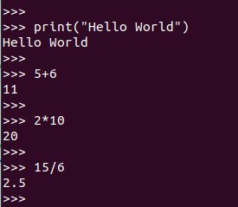
Why Python?
It’s almost close to HUMAN language.
Python is simple and so easy to learn.
Python is Open Source which means its available free of cost.
Python works on different platforms (Windows, Mac, Linux, Raspberry Pi, etc).
Python is much in demand and ensures high salary in tech related JOB.
Python has powerful development libraries include AI, ML etc.

Slide 4
Python Job Markets
Python is very high in demand and all the major international companies nowadays.
Today a Python Programmer with 3-5 years of experience is asking for around $150,000 annual package.
Google
Intel
NASA
PayPal
Facebook
IBM
Amazon
Netflix
Pinterest
Uber and many more.

Slide 5
Careers in Python
Game developer
Web designer
Python developer
Full-stack developer
Machine learning engineer
Data scientist
Data analyst
Data engineer
DevOps engineer
Software engineer

Slide 6
Characteristics of Python
It supports functional and structured programming methods as well as OOP.
It can be used as a scripting language or can be compiled to bytecode for building large applications.
It provides very high-level dynamic data types and supports dynamic type checking.
It supports automatic garbage collection. It can be easily integrated with C, C++, COM, ActiveX, CORBA, and Java.

Slide 7
Our Goal
Basic of Python
Creating simple program
Introducing 2/3 modules/library (Pandas, NumPy, MatSciPy)
Implementing simple AI/ML based Application

Slide 8
Python Environment Setup
Download and install latest version of python (https://www.python.org/downloads/windows/)
IDE (Integrated Development Environment)
PyCharm (Community version): https://www.jetbrains.com/pycharm/

Slide 9
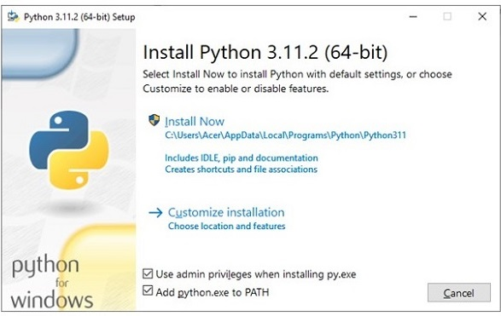
Python Environment Setup
Download & Install Python: https://www.python.org/downloads/windows/
Double click on the file where it has been downloaded to start the installation.
Click the Install Now button, it is advised to choose the installation folder with a relatively shorter path, and tick the second check box to update the PATH variable.

Slide 10
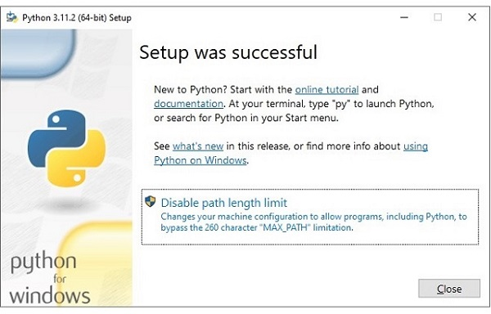
Python Environment Setup
Download & Install Python: https://www.python.org/downloads/windows/
Double click on the file where it has been downloaded to start the installation.
Click the Install Now button, it is advised to choose the installation folder with a relatively shorter path, and tick the second check box to update the PATH variable.
Wait a moment it shows Successful message.

Slide 11
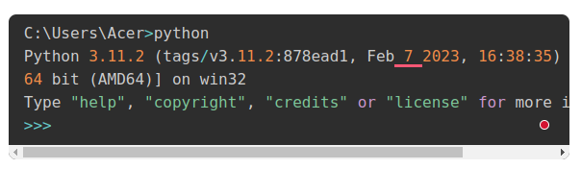
Python Environment Setup
Open the Window Command Prompt terminal and run Python to check the success of installation.
Open the Run menu with Windows Key + R, then type "cmd." Press "Enter" to open the regular Command Prompt.
or Ctrl + Shift + Enter to open as an Administrator.

Slide 12
Python Environment Setup (path setting)
To add the Python directory to the path for a particular session in Windows −
At the command prompt − type path %path%;C:\Python and press Enter.
Note − C:\Python is the path of the Python directory

Slide 13
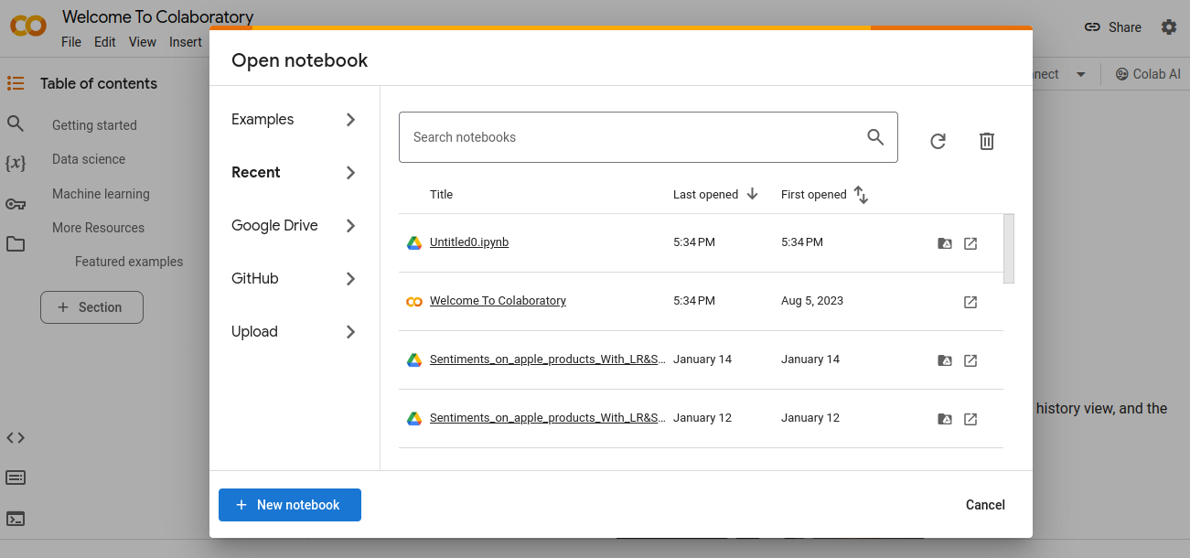
Python Environment (ONLINE)
Google Colab: https://colab.research.google.com/

Slide 14
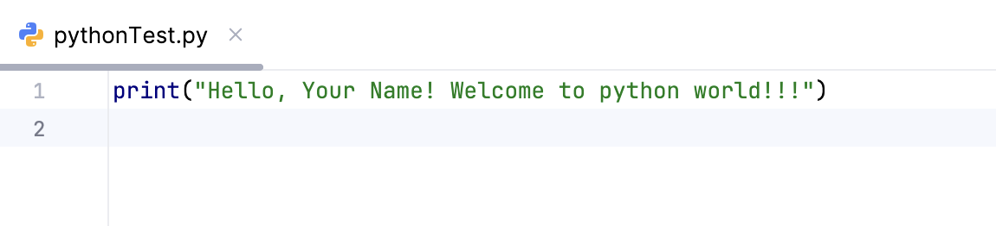
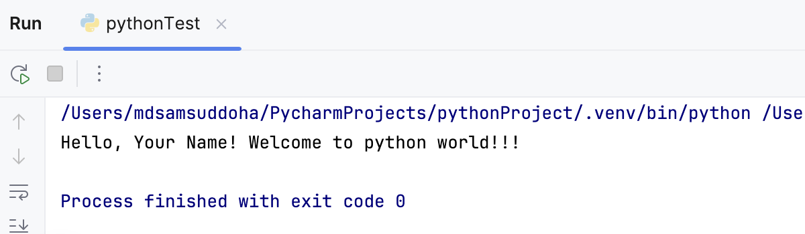
Start with Python
Open your editor(PyCharm) and write your first code.

Slide 15
Python Syntax (Identifiers)
A python identifier is a name to identify a variable, function, class, module or other objects.
Naming Conventions for Python Identifiers:
Identifiers cannot be a keyword.
Identifiers are case-sensitive. (AGE, age, Age are three different identifiers)
It can contain alpha-numeric characters and underscores (A-z, 0-9, and _ ). However, it must begin with a letter or underscore ( _ ). The first letter of an identifier cannot be a digit.
It's a convention to start an identifier with a letter rather _.
White Spaces are not allowed.
We cannot use special symbols like !, @, #, $, and so on.

Slide 16
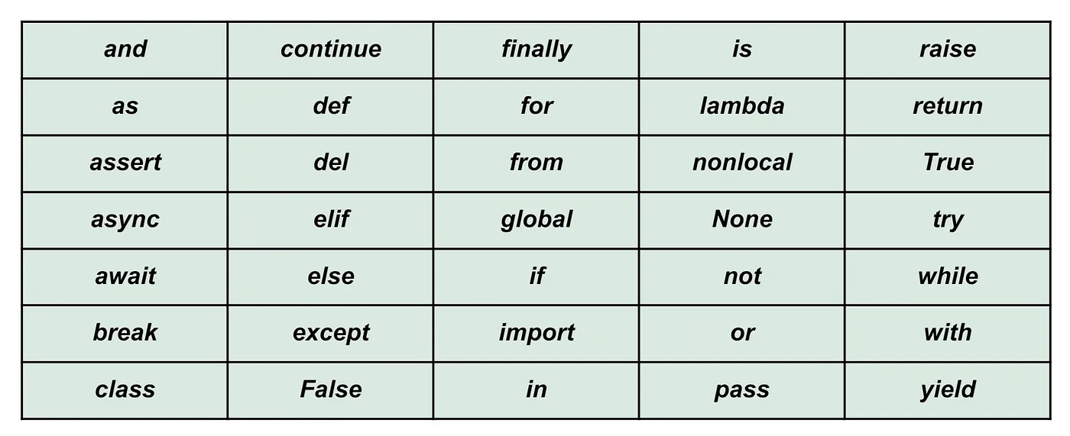
Python Syntax (Reserved Keywords)
For Details About Keywords: https://www.digitalocean.com/community/tutorials/python-keywords-identifiers

Slide 17
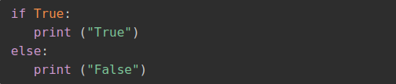
Python Syntax (Lines & Indentation)
Python programming provides no braces to indicate blocks of code for class and function definitions or flow control.
Blocks of code are denoted by line indentation, which is rigidly enforced.
The number of spaces in the indentation is variable, but all statements within the block must be indented the same amount. For example −

Slide 18
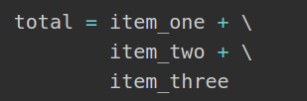
Python Syntax (Multi-Line Statements)
Use of the line continuation character (\)

Slide 19

Python Syntax (Multi-Line Statements) Cnt.
Statements contained within the [], {}, or () brackets do not need to use the line continuation character.

Slide 20

Python Syntax (Comments in Python)
A comment is a programmer-readable explanation or annotation in the Python source code that ignored by Python interpreter.
Single Line Comment: use #

Slide 21
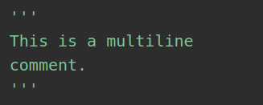
Python Syntax (Comments in Python)
A comment is a programmer-readable explanation or annotation in the Python source code that ignored by Python interpreter.
Multi Line Comment: use ‘ ‘ ‘ text ’ ’ ’

Slide 22
